Slide 1

Data Crunchers
Inge La Riviere, Rob Knapen, Roland Hangelbroek, Sjoerd Boersma
31 mei en 1 juni 2018

Slide 2

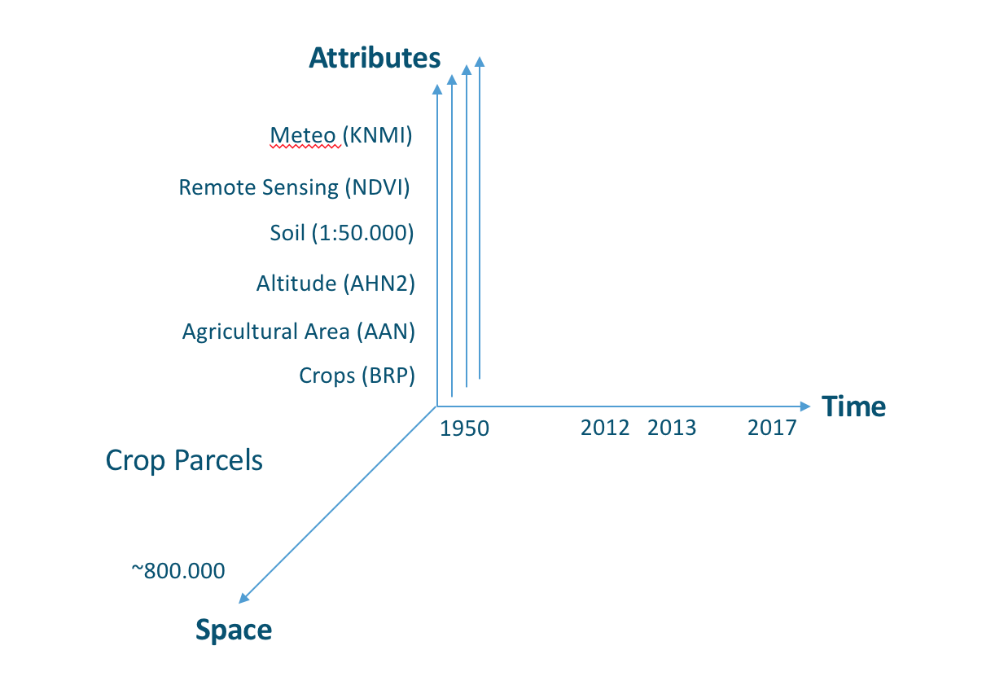
AgroDataCube

Slide 3
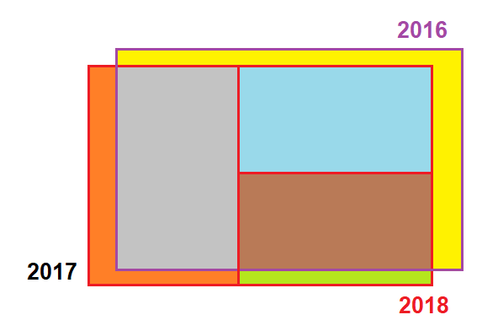
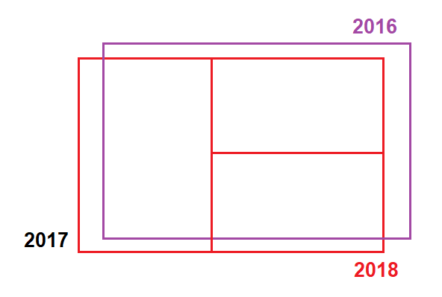

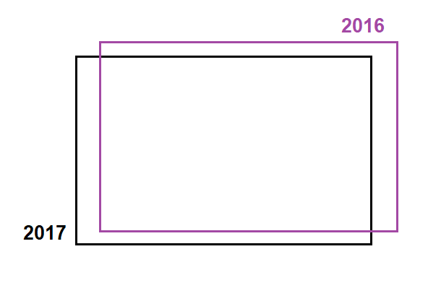
Percelen

Slide 4
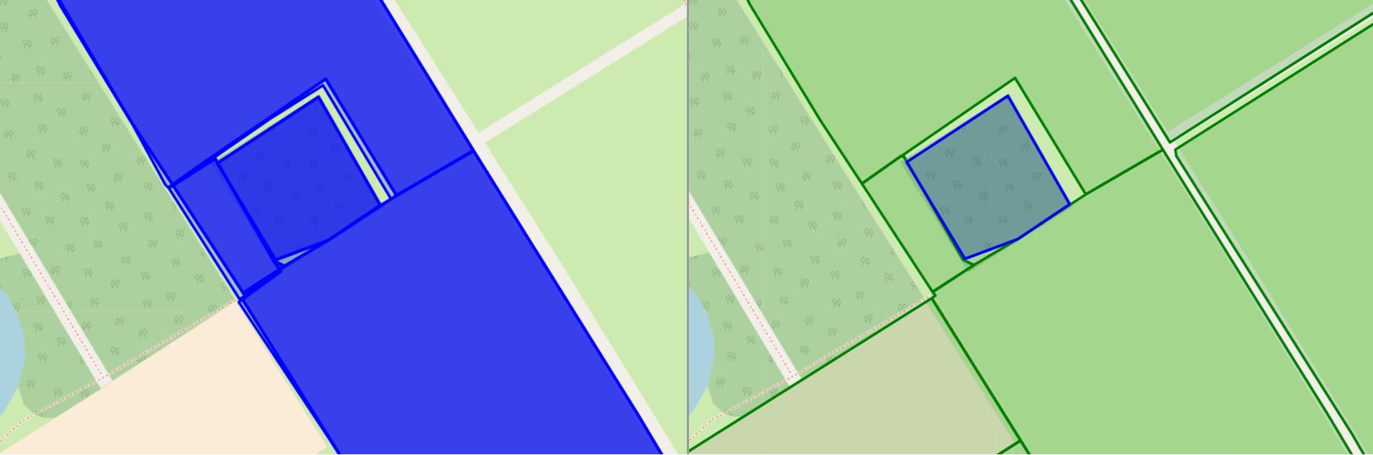
Percelen

Slide 5
AgroDataCube
http://agrodatacube.wur.nl/api/v1/rest/fields?output_epsg=4326&page_size=20&page_offset=0&year=2017&geometry=POLYGON((6.3 52.02, 6.3 52.04, 6.4 52.04, 6.4 52.02, 6.3 52.02))&epsg=4326
{'type': 'FeatureCollection', 'features': [{'type': 'Feature', 'geometry': {'type': 'MultiPolygon', 'coordinates': [[[[6.3397977, 52.0366356], [6.339763, 52.0366534], [6.3419601, 52.0375378], [6.3419779, 52.0375266], [6.3419844, 52.0375224], [6.3397977, 52.0366356]]]]}, 'properties': {'year': 2017, 'crop_code': '344', 'crop_name': 'Rand, grenzend aan blijvend grasland of een blijvende teelt, hoofdzakelijk bestaand uit een ander gewas dan gras', 'fieldid': 4007145, 'area': 477.19632160001674, 'perimeter': 365.1029604770122}}, {'type': 'Feature', 'geometry': {'type': 'MultiPolygon', 'coordinates': [[[[6.3555725, 52.0355125], [6.3546615, 52.03497], [6.3545854, 52.034929], [6.3536294, 52.0360142], [6.3535202, 52.0360484], [6.3534635, 52.0360471], [6.353445, 52.0360466], [6.3530275, 52.0359097], [6.3527059, 52.0362858], [6.3542424, 52.0368204], [6.3555725, 52.0355125]]]]}, 'properties': {'year': 2017, 'crop_code': '266', 'crop_name': 'Grasland, tijdelijk', 'fieldid': 4007623, 'area': 17698.5974905882, 'perimeter': 617.3789040256866}}, {'type': 'Feature', 'geometry': {'type': 'MultiPolygon', 'coordinates': [[[[6.3421857, 52.0353545], [6.3421648, 52.0353653], [6.3419382, 52.0354832], [6.3406596, 52.0361643], [6.3400291, 52.0364993], [6.3399361, 52.0365513], [6.3399518, 52.0365943], [6.3399658, 52.0366281], [6.3410502, 52.0370487], [6.3417504, 52.037322], [6.341973, 52.0370575], [6.342378, 52.036559], [6.3430524, 52.0356961], [6.3429968, 52.0356716], [6.3429682, 52.0356616], [6.3429681, 52.0356616], [6.3421857, 52.0353545]], [[6.3429651, 52.0356608], [6.3430504, 52.0356955], [6.3430111, 52.0357479], [6.343004, 52.0357568], [6.3429982, 52.035764], [6.3429861, 52.0357796], [6.342975, 52.0357931], [6.342965, 52.0358068], [6.3429231, 52.0358611], [6.3428952, 52.0358956], [6.3428788, 52.0359181], [6.3423481, 52.0365766], [6.3420968, 52.0369033], [6.3418337, 52.0372228], [6.3417489, 52.0373187], [6.3416822, 52.0372916], [6.3417342, 52.0372235], [6.341761, 52.0371884], [6.3429651, 52.0356608]]]]}, 'properties': {'year': 2017, 'crop_code': '259', 'crop_name': 'Mais, snij-', 'fieldid': 4007917, 'area': 21231.815580846418, 'perimeter': 1045.448230417561}}, {'type': 'Feature', 'geometry': {'type': 'MultiPolygon', 'coordinates': [[[[6.3397652, 52.036655], [6.3389995, 52.0370645], [6.3397373, 52.0373744], [6.3391918, 52.0378309], [6.3416142, 52.0383126], [6.3420147, 52.0375612], [6.3419435, 52.0375325], [6.3397669, 52.0366557], [6.3397652, 52.036655]]]]}, 'properties': {'year': 2017, 'crop_code': '259', 'crop_name': 'Mais, snij-', 'fieldid': 4007918, 'area': 20373.956844994893, 'perimeter': 640.8821195620358}}, {'type': 'Feature', 'geometry': {'type': 'MultiPolygon', 'coordinates': [[[[6.3352979, 52.0261742], [6.3354783, 52.0261435], [6.3354952, 52.0261812], [6.3355825, 52.026173], [6.3356157, 52.0262505], [6.3357618, 52.0261444], [6.3358301, 52.0260649], [6.3358533, 52.026016], [6.3346941, 52.0256736], [6.3344845, 52.0256075], [6.3343538, 52.0255536], [6.3342428, 52.025496], [6.3338767, 52.0252493], [6.333221, 52.0262757], [6.3339842, 52.0264479], [6.3351664, 52.0265585], [6.3350365, 52.0264246], [6.3350602, 52.0263599], [6.3352604, 52.0262191], [6.3353138, 52.0262066], [6.3352979, 52.0261742]]]]}, 'properties': {'year': 2017, 'crop_code': '265', 'crop_name': 'Grasland, blijvend', 'fieldid': 4011163, 'area': 13147.748753771713, 'perimeter': 539.5355871270131}}, {'type': 'Feature', 'geometry': {'type': 'MultiPolygon', 'coordinates': [[[[6.3258682, 52.0331983], [6.3258745, 52.0330484], [6.3241128, 52.0324678], [6.3238811, 52.0325117], [6.3239379, 52.0327727], [6.3239404, 52.0328876], [6.3236708, 52.0329017], [6.3236413, 52.0330247], [6.3235559, 52.0332433], [6.3224102, 52.0333194], [6.3236705, 52.0356002], [6.3236839, 52.0356115], [6.3266078, 52.035126], [6.3267256, 52.0350771], [6.3267706, 52.0350429], [6.3259257, 52.0333275], [6.3258682, 52.0331983]]]]}, 'properties': {'year': 2017, 'crop_code': '2017', 'crop_name': 'Aardappelen, zetmeel', 'fieldid': 4020822, 'area': 63710.14454811, 'perimeter': 1055.42885333122}}, {'type': 'Feature', 'geometry': {'type': 'MultiPolygon', 'coordinates': [[[[6.3485004, 52.0224924], [6.3483579, 52.0221684], [6.3482496, 52.0221821], [6.3481852, 52.0219815], [6.3479572, 52.0220092], [6.3480084, 52.0223488], [6.3481237, 52.0229054], [6.3483757, 52.0228593], [6.3482258, 52.0225412], [6.3485004, 52.0224924]]]]}, 'properties': {'year': 2017, 'crop_code': '265', 'crop_name': 'Grasland, blijvend', 'fieldid': 4020959, 'area': 2065.6637425349218, 'perimeter': 258.542462142203}}, {'type': 'Feature', 'geometry': {'type': 'MultiPolygon', 'coordinates': [[[[6.3460524, 52.026601], [6.3455703, 52.0259736], [6.3453625, 52.0260288], [6.3454179, 52.0261049], [6.3454224, 52.0261034], [6.345591, 52.0263017], [6.3456091, 52.026336], [6.3456034, 52.0263878], [6.3457412, 52.0265644], [6.3456399, 52.0266057], [6.3456409, 52.0266155], [6.3456552, 52.0266333], [6.345742, 52.0266675], [6.3457786, 52.0266734], [6.3459719, 52.0266256], [6.3460524, 52.026601]]]]}, 'properties': {'year': 2017, 'crop_code': '266', 'crop_name': 'Grasland, tijdelijk', 'fieldid': 4021232, 'area': 1336.8994666344224, 'perimeter': 200.6856527291531}}, {'type': 'Feature', 'geometry': {'type': 'MultiPolygon', 'coordinates': [[[[6.349423, 52.0309046], [6.3470714, 52.0294452], [6.3468547, 52.0296116], [6.3465638, 52.0298451], [6.3464369, 52.0299591], [6.349096, 52.0315178], [6.3497882, 52.0311404], [6.3496693, 52.0310631], [6.3495579, 52.0309903], [6.349423, 52.0309046]]]]}, 'properties': {'year': 2017, 'crop_code': '266', 'crop_name': 'Grasland, tijdelijk', 'fieldid': 4021233, 'area': 17505.85424116497, 'perimeter': 652.2619371710733}}, {'type': 'Feature', 'geometry': {'type': 'MultiPolygon', 'coordinates': [[[[6.4006085, 52.0352663], [6.4004032, 52.0352821], [6.4004022, 52.035276], [6.3991971, 52.0353626], [6.3991994, 52.0353738], [6.399183, 52.0353752], [6.399183, 52.0353753], [6.3991779, 52.0353757], [6.3984691, 52.035432], [6.3976704, 52.0355055], [6.397785, 52.0359979], [6.3977851, 52.0359982], [6.3979192, 52.0365749], [6.3979214, 52.0365513], [6.4008387, 52.0363095], [6.4008311, 52.0363065], [6.4008019, 52.0362138], [6.4007982, 52.036202], [6.4007625, 52.0360208], [6.4006085, 52.0352663]]]]}, 'properties': {'year': 2017, 'crop_code': '259', 'crop_name': 'Mais, snij-', 'fieldid': 4023609, 'area': 23942.05014652276, 'perimeter': 647.5119974438728}}, {'type': 'Feature', 'geometry': {'type': 'MultiPolygon', 'coordinates': [[[[6.399109, 52.0341923], [6.3990213, 52.0341965], [6.3990069, 52.0341972], [6.3991202, 52.0347014], [6.3991312, 52.0347503], [6.3991313, 52.0347507], [6.4002896, 52.0346445], [6.4002895, 52.0346442], [6.3999102, 52.034676], [6.3998876, 52.0345208], [6.3998869, 52.0345165], [6.3998934, 52.0345137], [6.3998933, 52.0345134], [6.3993237, 52.0345595], [6.399286, 52.0343826], [6.3991617, 52.0343917], [6.3991376, 52.0342924], [6.3991109, 52.0341988], [6.399109, 52.0341923]]]]}, 'properties': {'year': 2017, 'crop_code': '266', 'crop_name': 'Grasland, tijdelijk', 'fieldid': 4023610, 'area': 1522.748557683597, 'perimeter': 284.6008103007826}}, {'type': 'Feature', 'geometry': {'type': 'MultiPolygon', 'coordinates': [[[[6.4002895, 52.0346442], [6.4002384, 52.0343175], [6.3998733, 52.0343461], [6.3999074, 52.0345123], [6.3998933, 52.0345134], [6.3998934, 52.0345137], [6.3998869, 52.0345165], [6.3998876, 52.0345208], [6.3999102, 52.034676], [6.4002895, 52.0346442]]]]}, 'properties': {'year': 2017, 'crop_code': '259', 'crop_name': 'Mais, snij-', 'fieldid': 4023612, 'area': 936.3990891330649, 'perimeter': 126.03572037062014}}, {'type': 'Feature', 'geometry': {'type': 'MultiPolygon', 'coordinates': [[[[6.3199555, 52.039789], [6.3201269, 52.0397645], [6.3201335, 52.0397748], [6.3208261, 52.0396464], [6.3208308, 52.0396342], [6.3206539, 52.039316], [6.3208159, 52.0392736], [6.3210884, 52.039206], [6.3212281, 52.0391592], [6.3210941, 52.039005], [6.3207363, 52.0392438], [6.3205314, 52.0391267], [6.3201199, 52.0393933], [6.3201333, 52.0394449], [6.3201094, 52.0394816], [6.3199271, 52.0397342], [6.3199507, 52.0397896], [6.3199555, 52.039789]]]]}, 'properties': {'year': 2017, 'crop_code': '265', 'crop_name': 'Grasland, blijvend', 'fieldid': 4024442, 'area': 3000.058962507538, 'perimeter': 308.33169817198205}}, {'type': 'Feature', 'geometry': {'type': 'MultiPolygon', 'coordinates': [[[[6.3036089, 52.0214906], [6.303632, 52.0214292], [6.3036367, 52.0214294], [6.3037922, 52.0210037], [6.3039063, 52.0208631], [6.3026759, 52.0208607], [6.3025157, 52.0206467], [6.3024746, 52.0206185], [6.3023696, 52.0204889], [6.3022989, 52.0203673], [6.3020917, 52.0198722], [6.301396, 52.0197078], [6.3010567, 52.0202696], [6.3009854, 52.0203115], [6.3009166, 52.0203432], [6.3007561, 52.0204069], [6.3005401, 52.0204759], [6.3009004, 52.0209789], [6.3016802, 52.0220144], [6.3036089, 52.0214906]]]]}, 'properties': {'year': 2017, 'crop_code': '265', 'crop_name': 'Grasland, blijvend', 'fieldid': 4025249, 'area': 28838.05301601135, 'perimeter': 768.8120156825498}}, {'type': 'Feature', 'geometry': {'type': 'MultiPolygon', 'coordinates': [[[[6.3546429, 52.0236591], [6.3540783, 52.0232923], [6.3539907, 52.0231919], [6.3540264, 52.0232371], [6.3540672, 52.0232865], [6.3540635, 52.0232841], [6.3540764, 52.0233005], [6.3539799, 52.0232382], [6.3540533, 52.0232961], [6.3537939, 52.0231184], [6.3528545, 52.0225126], [6.3528483, 52.0225082], [6.3528389, 52.022504], [6.3527218, 52.0224247], [6.3526733, 52.0223828], [6.3516426, 52.0216442], [6.3513852, 52.0216663], [6.3513789, 52.0216443], [6.3509467, 52.021684], [6.3505516, 52.021723], [6.3505351, 52.0217193], [6.3499242, 52.0217953], [6.3499175, 52.0217961], [6.3499094, 52.0217971], [6.3498842, 52.0218002], [6.3498872, 52.0222026], [6.3498895, 52.0223404], [6.3498971, 52.0226375], [6.3497831, 52.0226027], [6.3497831, 52.0226028], [6.3499068, 52.0226407], [6.3500126, 52.0226669], [6.3500665, 52.0226778], [6.3503387, 52.0227475], [6.350595, 52.0228357], [6.350837, 52.0229764], [6.3513538, 52.023342], [6.3514805, 52.0234088], [6.3517996, 52.0235453], [6.3520232, 52.0236386], [6.3529688, 52.0239555], [6.3534867, 52.0241333], [6.3539058, 52.0239629], [6.3546429, 52.0236591]]]]}, 'properties': {'year': 2017, 'crop_code': '1002', 'crop_name': 'Lelie, bloembollen en -knollen', 'fieldid': 4025579, 'area': 43976.69590657916, 'perimeter': 979.5886610431089}}, {'type': 'Feature', 'geometry': {'type': 'MultiPolygon', 'coordinates': [[[[6.3109657, 52.0327059], [6.3109436, 52.0327114], [6.3109455, 52.0327142], [6.310234, 52.0328892], [6.3093664, 52.0331066], [6.3105872, 52.0347349], [6.3110323, 52.0346061], [6.3111037, 52.0347075], [6.3113987, 52.0350932], [6.3125152, 52.0349643], [6.3118375, 52.0339766], [6.3117232, 52.0338127], [6.311418, 52.0333669], [6.3109657, 52.0327059]]]]}, 'properties': {'year': 2017, 'crop_code': '259', 'crop_name': 'Mais, snij-', 'fieldid': 4029015, 'area': 27983.349353640595, 'perimeter': 762.6838563290726}}, {'type': 'Feature', 'geometry': {'type': 'MultiPolygon', 'coordinates': [[[[6.312755, 52.0261974], [6.3123036, 52.0262061], [6.3127009, 52.0270785], [6.3128373, 52.0273792], [6.314094, 52.0271108], [6.3139995, 52.0269599], [6.313354, 52.0271112], [6.3132672, 52.0271079], [6.3128631, 52.0262297], [6.312755, 52.0261974]]]]}, 'properties': {'year': 2017, 'crop_code': '265', 'crop_name': 'Grasland, blijvend', 'fieldid': 4029494, 'area': 5653.482091912701, 'perimeter': 439.0215347881115}}, {'type': 'Feature', 'geometry': {'type': 'MultiPolygon', 'coordinates': [[[[6.3549098, 52.0333752], [6.3545995, 52.0314344], [6.3518732, 52.0315842], [6.3519118, 52.0318501], [6.3519288, 52.0320341], [6.3519417, 52.0321121], [6.3516805, 52.0322312], [6.3510905, 52.0324964], [6.3508155, 52.0326164], [6.3513895, 52.032953], [6.3523924, 52.0335382], [6.354862, 52.033398], [6.3549098, 52.0333752]]]]}, 'properties': {'year': 2017, 'crop_code': '266', 'crop_name': 'Grasland, tijdelijk', 'fieldid': 4029512, 'area': 47187.55682398648, 'perimeter': 882.6891363117286}}, {'type': 'Feature', 'geometry': {'type': 'MultiPolygon', 'coordinates': [[[[6.3116145, 52.0258509], [6.3097925, 52.025954], [6.308765, 52.026021], [6.3088637, 52.0267711], [6.3081924, 52.0268225], [6.3082493, 52.027348], [6.3082501, 52.0273482], [6.3089096, 52.0274914], [6.3089519, 52.0274988], [6.3093391, 52.0275666], [6.3093494, 52.0275672], [6.309424, 52.0275718], [6.3094973, 52.0275736], [6.3095377, 52.0275686], [6.3095709, 52.0275618], [6.3095799, 52.0275599], [6.3096602, 52.027526], [6.3097264, 52.0274939], [6.3097823, 52.0274667], [6.3098526, 52.0274211], [6.3103384, 52.0271059], [6.3103777, 52.0270804], [6.3104482, 52.0270192], [6.31048, 52.0269916], [6.3105613, 52.0269172], [6.3107027, 52.0267627], [6.3108505, 52.0266017], [6.3109403, 52.026504], [6.3110458, 52.0263843], [6.3111973, 52.0262547], [6.3113943, 52.0260842], [6.3115882, 52.0258793], [6.3116074, 52.025859], [6.3116145, 52.0258509]]]]}, 'properties': {'year': 2017, 'crop_code': '265', 'crop_name': 'Grasland, blijvend', 'fieldid': 4029789, 'area': 25718.728351232574, 'perimeter': 718.5629307017118}}, {'type': 'Feature', 'geometry': {'type': 'MultiPolygon', 'coordinates': [[[[6.3507992, 52.0379218], [6.3499115, 52.0387864], [6.3490124, 52.039674], [6.3490723, 52.0396927], [6.3494157, 52.039824], [6.3493963, 52.0398454], [6.3491237, 52.0401687], [6.3497983, 52.0404271], [6.3501174, 52.0402913], [6.3502092, 52.0402608], [6.351084, 52.0394726], [6.3514599, 52.0391446], [6.3514843, 52.0391222], [6.3521911, 52.0384545], [6.3507992, 52.0379218]]]]}, 'properties': {'year': 2017, 'crop_code': '235', 'crop_name': 'Gerst, winter-', 'fieldid': 4030023, 'area': 27951.20513934538, 'perimeter': 749.2345747858773}}]}

Slide 6
Demo
http://localhost:1000/

